Slide 1
Revisiting Random Channel Pruning for Neural Network Compression
Yawei Li, Kamil Adamczewski, Wen Li, Shuhang Gu, Radu Timofte, Luc Van Gool; Proceedings of the IEEE/CVF Conference on Computer Vision and Pattern Recognition (CVPR), 2022, pp. 191-201
Presentation of Federico Bussolino(s317641), Abolfazl Javidian(s314441), Francesco Baracco(s317743)

Slide 2
Channel Pruning for Neural Network (Javidian)
Definition:
Channel pruning is a technique used in the optimization of neural networks, particularly deep convolutional neural networks (CNNs).
Goal:
The goal of channel pruning is to “reduce the computational cost and memory requirements maintaining a good accuracy” of a neural network by identifying and removing unnecessary channels (feature maps) in each layer.
Note:
While channel pruning can significantly reduce the computational cost of a neural network, the degree of pruning and its impact on model performance depend on the specific architecture, dataset, and task at hand. Therefore, “careful experimentation and validation” are essential when applying channel pruning to a neural network.

Slide 3
Why and How (Javidian)
Convolutional Layers and Channels:
In a CNN, convolutional layers consist of multiple channels, each producing a set of feature maps. These feature maps capture different patterns and spatial hierarchies in the input data. However, not all channels are equally important for the network's performance.
Importance Metrics:
Channel pruning methods typically involve defining metrics to measure the importance of each channel. These metrics can include the L1 or L2 norm of the channel's weights, activation values, or gradients during training. Channels that contribute less to the network's performance are candidates for pruning.
Thresholding:
A threshold is applied to identify channels whose importance falls below a certain criterion. Channels with values below this threshold are considered less crucial and are candidates for removal. The threshold for pruning can be determined using various criteria, such as a fixed percentage of the lowest importance channels, a global threshold for the entire layer, or an adaptive threshold based on a validation set.
Types of pruning:
Unstructured: removes individual channels without considering their spatial location in the input data.
Structured: preserves spatial structures by removing entire filters or filter groups, maintaining the connectivity patterns within each channel.

Slide 4
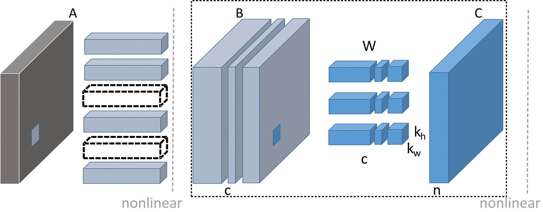
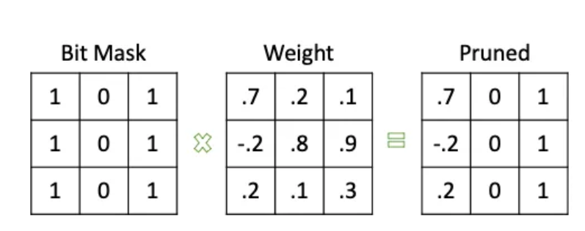
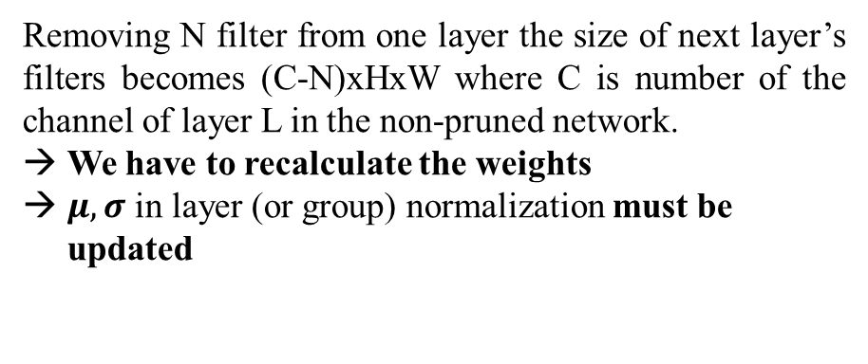
Channel level pruning Weight level pruning
Pruning (Javidian)
Removing N filter from one layer the size of next layer’s filters becomes (C-N)xHxW where C is number of the channel of layer L in the non-pruned network.
We have to recalculate the weights
$μ, σ$ in layer (or group) normalization must be updated
Removing just weights doesn’t change the shape of next layer filters.

Slide 5

Properties of channel pruning space (Javidian)
Property 1:
The channel configuration space is discrete, so conducting a differentiable analysis in this space is impossible. This property constitutes a major challenge for channel pruning and architecture search methods. To search for the space, reinforcement learning, evolutionary algorithm, and proximal gradient descent have been utilized.
Property 2:
Slightly changing the channel number of a network does not change the accuracy of the network too much. Regularization-based methods gradually update from initial networks to the optimal solutions. By contrast, random pruning only needs to get a sample in the neighborhood of the optimal solution instead of the optimal solution itself.

Slide 6
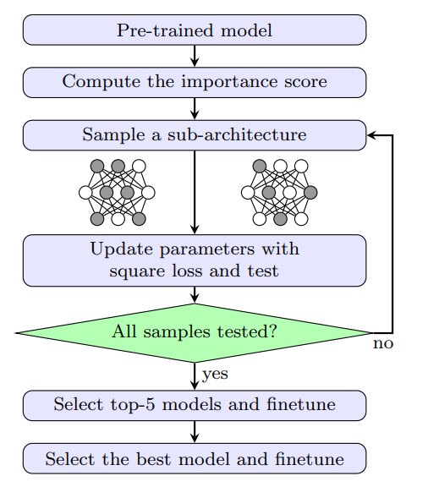
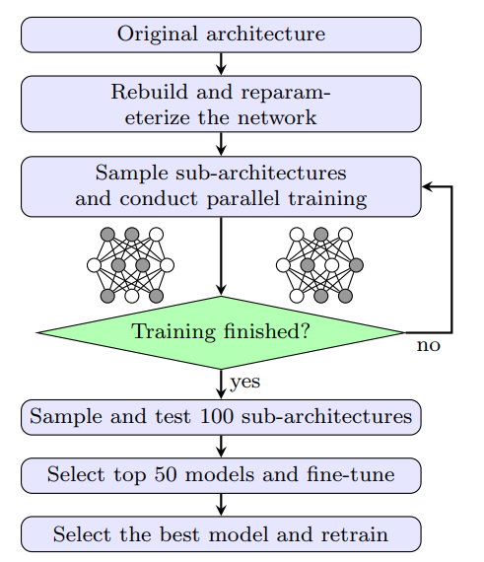

Methodology (Javidian)
The paper aims to show performances of random pruning in two different contexts:
pruning pre-trained network
pruning network from scratch
1
2
3
2,3
4,5
4,5
6,7
6,7

Slide 7
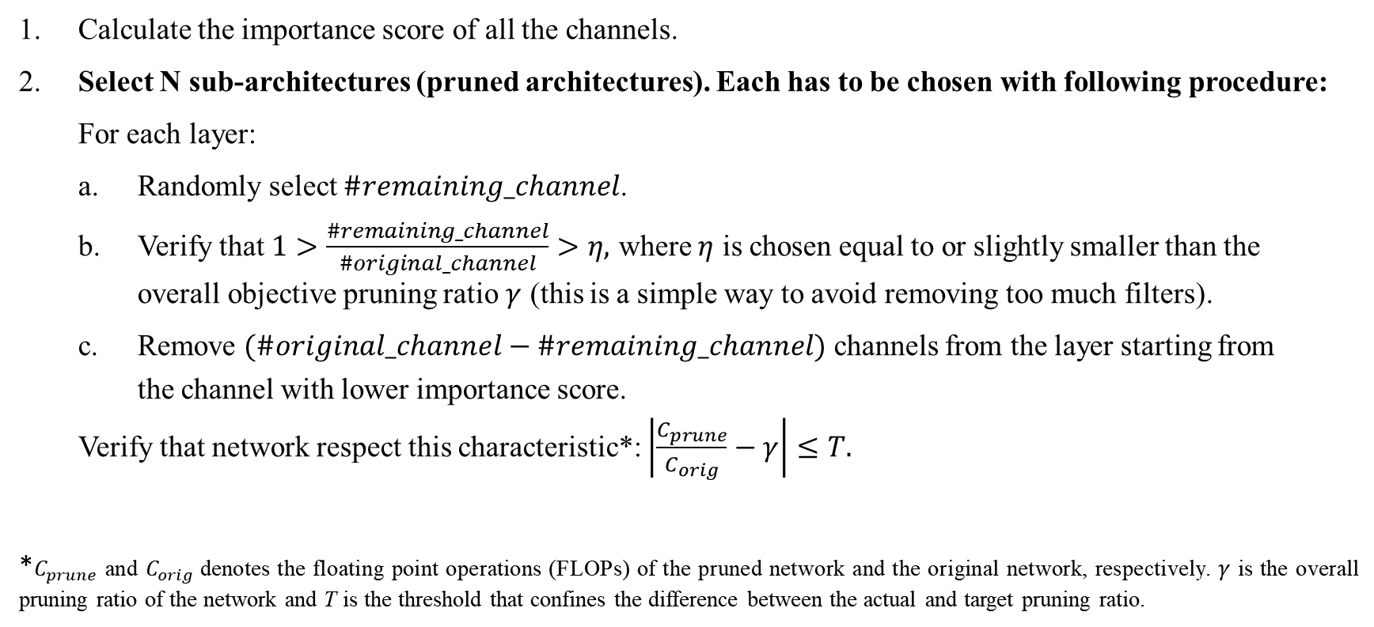
Pruning Pre-trained network (Federico) Importance score and sampling sub-networks
Calculate the importance score of all the channels.
Select N sub-architectures (pruned architectures). Each has to be chosen with following procedure:
For each layer:
a. Randomly select $\#remaining_channel$.
b. Verify that $1>\frac{\#remaining_channel}{\#original_channel}>η,$ where $η$ is chosen equal to or slightly smaller than the overall objective pruning ratio $γ$ (this is a simple way to avoid removing too much filters).
c. Remove $(\#original_channel−\#remaining_channel)$ channels from the layer starting from
the channel with lower importance score.
Verify that network respect this characteristic*: $\left|\frac{C_{prune}}{C_{orig}}−γ\right|≤T.$
*$C_{prune}$ and $C_{orig}$denotes the floating point operations (FLOPs) of the pruned network and the original network, respectively. $γ$ is the overall pruning ratio of the network and T is the threshold that confines the difference between the actual and target pruning ratio.

Slide 8
Pruning Pre-trained network (Federico) Updating parameters and selecting model
3. For each of the N sub-architectures:
a. Update parameter by minimizing difference between feature maps of pruned and original networks*
b. Evaluate accuracy on validation set
Top 5 performing models are selected among the N proposed
For each of those 5:
a. Fine-tune the selected model for several epochs
b. Evaluate accuracy on validation set
6. Select the model with best accuracy
7. Fine-tune for more epochs the best model
*Parameter updating is described in next slide

Slide 9

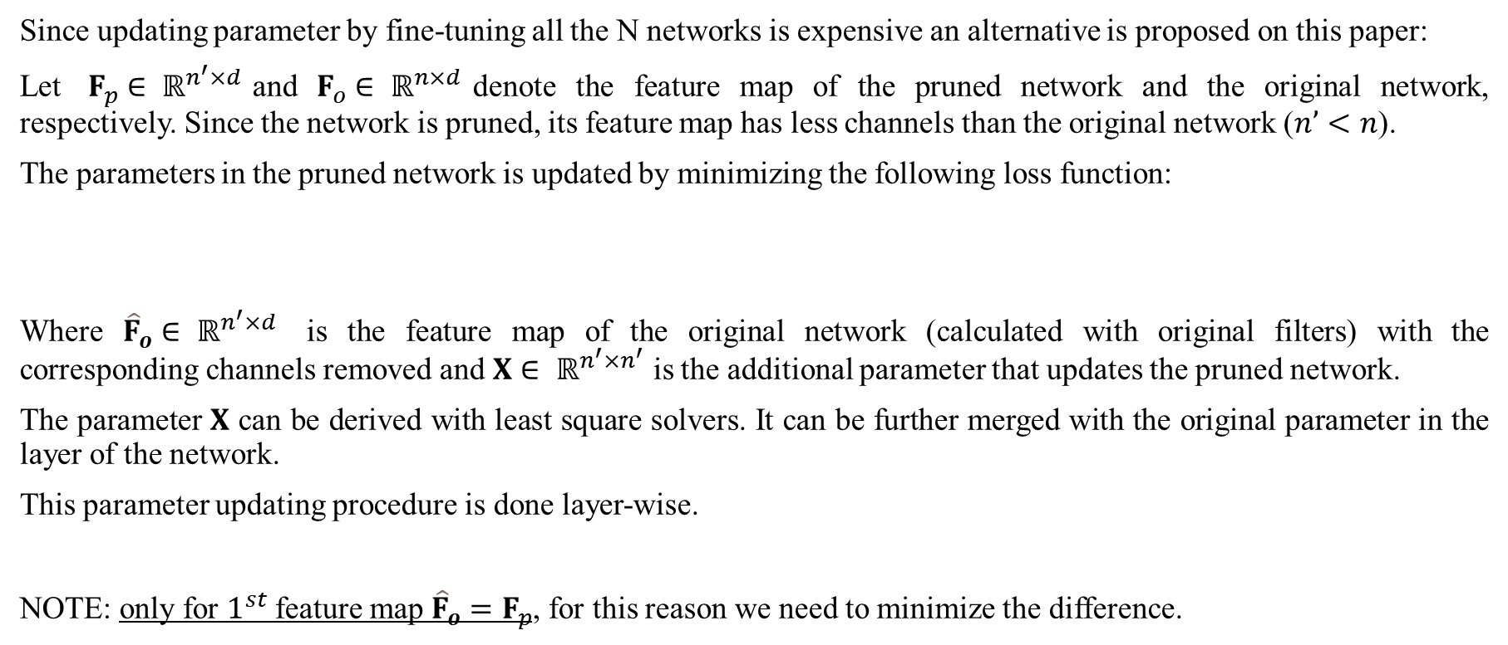
Pruning Pre-trained network (Federico, just mention) Updating parameters by minimizing distance between feature maps
Since updating parameter by fine-tuning all the N networks is expensive an alternative is proposed on this paper:
Let $F_{p}∈ ℝ^{n^{′}×d}$and $F_{o}∈ ℝ^{n×d}$denote the feature map of the pruned network and the original network, respectively. Since the network is pruned, its feature map has less channels than the original network ($n’<n$).
The parameters in the pruned network is updated by minimizing the following loss function:
Where ${\hat{F}}_{o}∈ ℝ^{n^{′}×d}$ is the feature map of the original network (calculated with original filters) with the corresponding channels removed and $X∈ ℝ^{n^{′}×n^{′}}$ is the additional parameter that updates the pruned network.
The parameter $X$ can be derived with least square solvers. It can be further merged with the original parameter in the layer of the network.
This parameter updating procedure is done layer-wise.
NOTE: only for $1^{st}$ feature map ${\hat{F}}_{o}=F_{p}$, for this reason we need to minimize the difference.

Slide 10
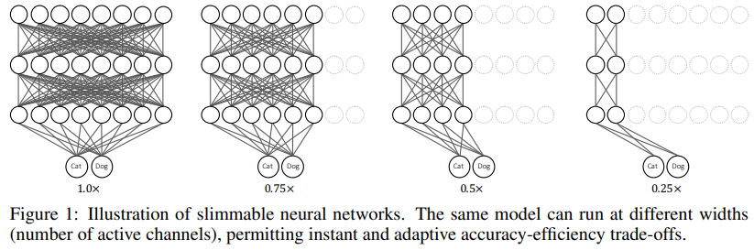
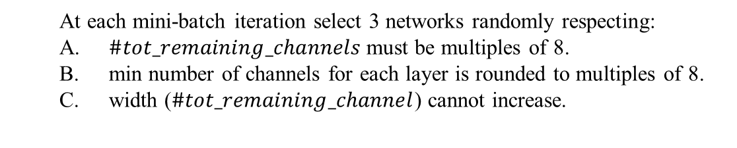
Pruning network from scratch (Federico) Training slimmable NN
Train a slimmable neural network (neural network that can be runned with different width, 4 in parallel)*
Figure shows an example of a slimmable network that can switch between four model variants with different numbers of active channels. The parameters of all model variants are shared. Switchable batch normalization, that privatizes batch normalization for different switches of a slimmable network allows to achieve good performances.
→ Thanks to parallel training the network will gain the capability of interpolating the accuracy of unsampled networks. “Make sure that even differently configured convolutional layers provide good results”
At each mini-batch iteration select 3 networks randomly respecting:
A. $\#tot_remaining_channels$must be multiples of 8.
B. min number of channels for each layer is rounded to multiples of 8.
C. width ($\#tot_remaining_channel$) cannot increase.

Slide 11

Pruning network from scratch (Federico)
Sampling sub-networks and selecting best model
2. Random smaple a population of N subnetwork (with the same process previously described):
For each layer:
a. Randomly select $\#remaining_channel$
b. Verify that $1>\frac{\#remaining_channel}{\#original_channel}>η,$ where $η$ is chosen equal to or slightly smaller than the overall objective pruning ratio $γ$
c. Remove $(\#original_channel−\#remaining_channel)$ channels from the layer starting from the channel with lower importance score.
Verify that network respect this characteristic*: $\left|\frac{C_{prune}}{C_{orig}}−γ\right|≤T$
3. For each of the N sub-architectures:
Directly evaluate accuracy on validation set using slimmable NN
4. Top 50 performing models are selected among the N proposed
5. For each of those 50:
a. Further train the selected model for some epochs
b. Evaluate accuracy on validation set
6. Select the model with best accuracy
7. Re-train the best model from scratch

Slide 12
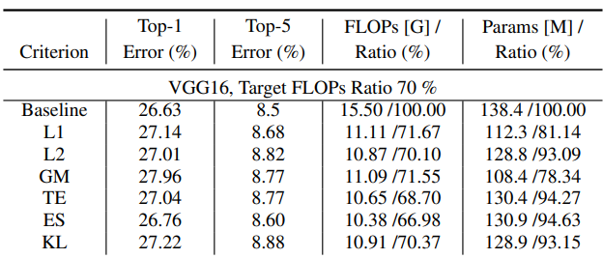
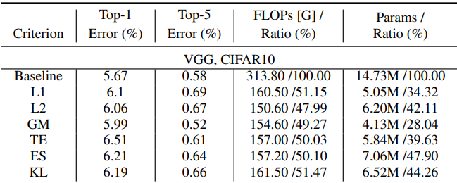
Experimental results (Francesco) Comparing importance score metrics
Here we report the network that obtained best benefit from random pruning
Benchmarking random channel pruning criteria on ImageNet:
Benchmarking random channel pruning criteria on CIFAR10:

Slide 13
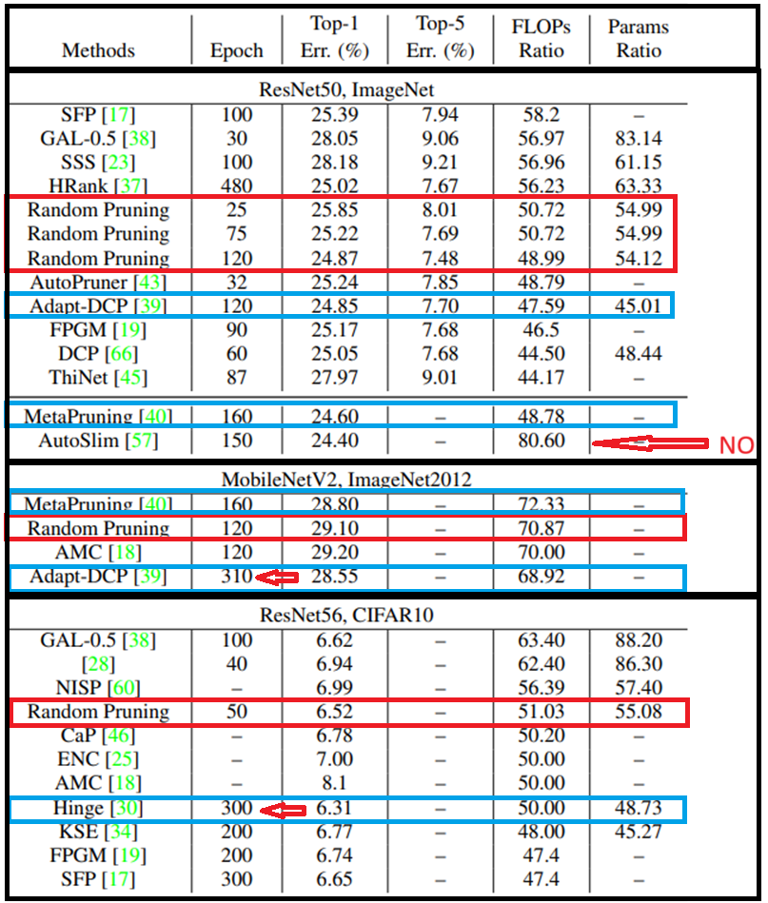
Experimental results (Francesco) Comparing random channel pruning with other methods
From the result we can see that Random Pruning perform well even when compared with more complex pruning methods.
NOTE: method that outperforms random pruning are usually trained for more epochs.

Slide 14
Conclusion (Francesco)
There are no clear winners among different channel importance evaluation methods.
Random pruning is a simple, general and explainable baseline which performs well.
Our understanding
Pros
No use of sophisticated algorithm
Great way to have an idea of performance of pruned model
Suggestions
With more complex algorithms we may obtain better results

Slide 15
Related works (Francesco)
Previous work about structured pruning:
Sajid Anwar, Kyuyeon Hwang, and Wonyong Sung. Structured pruning of deep convolutional neural networks. ACM Journal on Emerging Technologies in Computing Systems (JETC), 13(3):1–18, 2017
Before that the research was more focused on unstructured pruning
Other related paper investigates the different channel importance metrics:
L1/L2: Jianbo Ye, Xin Lu, Zhe Lin, and James Z Wang. Rethinking the smaller-norm-less-informative assumption in channel pruning of convolution layers. In Proceedings of International Conference on Learning Representations, 2018
GM: Yang He, Ping Liu, Ziwei Wang, Zhilan Hu, and Yi Yang. Filter pruning via geometric median for deep convolutional neural networks acceleration. In Proceedings of the IEEE Conference on Computer Vision and Pattern Recognition
TE: Babak Hassibi and David G Stork. Second order derivatives for network pruning: Optimal brain surgeon. In Advances in Neural Information Processing Systems, pages 164–171, 1993
KL: Jian-Hao Luo and Jianxin Wu. Neural network pruning with residual-connections and limited-data. In Proceedings of the IEEE/CVF Conference on Computer Vision and Pattern Recognition, pages 1458–1467, 2020
ES: Lucas Liebenwein, Cenk Baykal, Harry Lang, Dan Feldman, and Daniela Rus. Provable filter pruning for efficient neural networks. arXiv preprint arXiv:1911.07412, 2019
Works that followed:
Using random pruning as a baseline: ThinResNet: A New Baseline for Structured Convolutional Networks Pruning,

Slide 16
Multi-Granularity Pruning for Model Acceleration on Mobile Devices
Tianli Zhao, Xi Sheryl Zhang, Wentao Zhu, Jiaxing Wang Sen Yang , Ji Liu, and Jian Cheng
In book: Computer Vision – ECCV 2022, 17th European Conference, Tel Aviv, Israel, October 23–27, 2022, Proceedings, Part XI (pp.484-501)

Slide 17
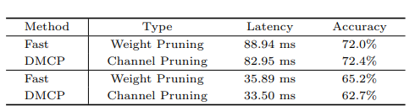
Study of the paper (Javidian)
Issue: The two mainstream pruning methods, channel and weight pruning, have varying impacts on latency and accuracy.
Objective: Can a refined network pruning method be designed to achieve an improved latency-accuracy trade-off?

Slide 18
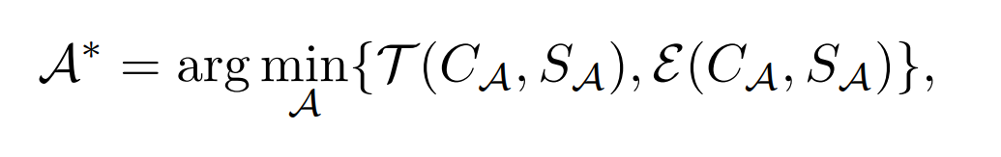
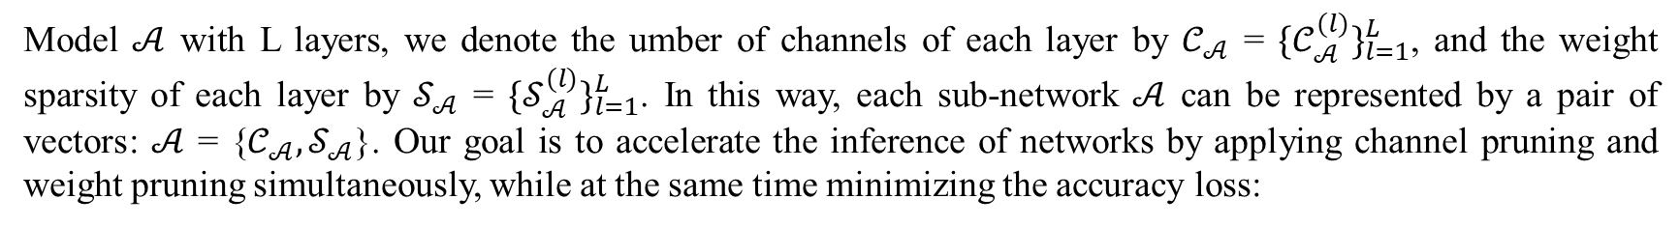
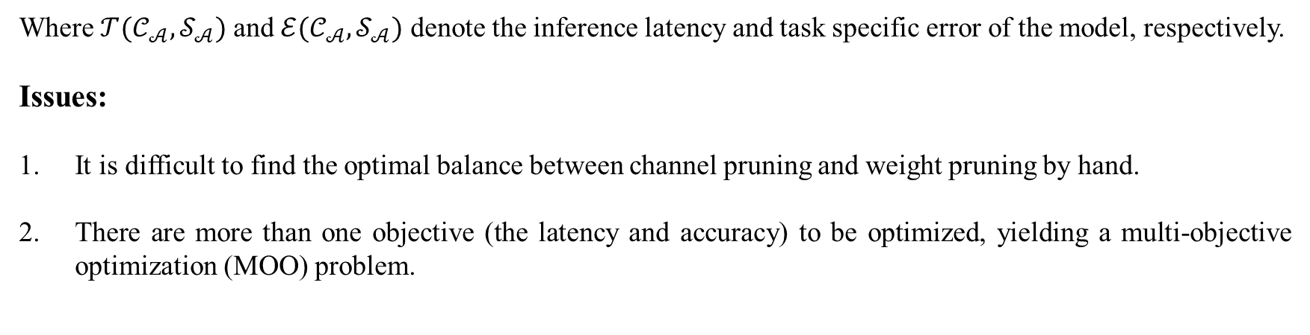
Problem formulation (Javidian)
Model $𝒜$ with L layers, we denote the umber of channels of each layer by $𝒞_{𝒜}$ = ${\{𝒞}_{𝒜}^{(l)}\}_{l=1}^{L}$, and the weight sparsity of each layer by $𝒮_{𝒜}$ = ${\{𝒮}_{𝒜}^{(l)}\}_{l=1}^{L}$. In this way, each sub-network $𝒜$ can be represented by a pair of vectors: $𝒜$ = {$𝒞_{𝒜},𝒮_{𝒜}$}. Our goal is to accelerate the inference of networks by applying channel pruning and weight pruning simultaneously, while at the same time minimizing the accuracy loss:
Where $𝒯(𝒞_{𝒜},𝒮_{𝒜})$ and $ℰ(𝒞_{𝒜},𝒮_{𝒜})$ denote the inference latency and task specific error of the model, respectively.
Issues:
It is difficult to find the optimal balance between channel pruning and weight pruning by hand.
There are more than one objective (the latency and accuracy) to be optimized, yielding a multi-objective optimization (MOO) problem.

Slide 19
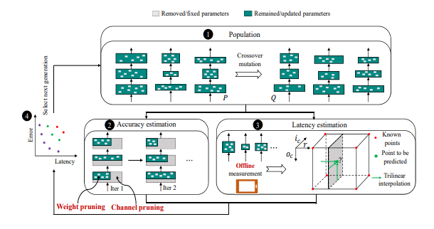
Joint Channel and Weight Pruning (Javidian)
By jointly exploring the optimal number of channels and layer-wise weight sparsity simultaneously, JCW automatically finds a balanced trade-off between channel and weight pruning for various latency budgets → Pareto-optimization evolutionary algorithm

Slide 20
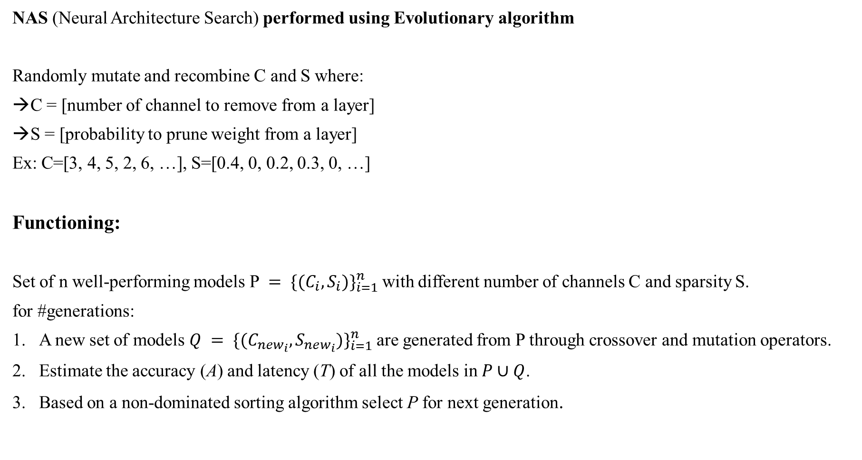
High level procedure (Francesco)
NAS (Neural Architecture Search) performed using Evolutionary algorithm
Randomly mutate and recombine C and S where:
C = [number of channel to remove from a layer]
S = [probability to prune weight from a layer]
Ex: C=[3, 4, 5, 2, 6, …], S=[0.4, 0, 0.2, 0.3, 0, …]
Functioning:
Set of n well-performing models P $= {\{(C_{i},S_{i})\}}_{i=1}^{n}$with different number of channels C and sparsity S.
for #generations:
A new set of models $Q = {\{(C_{new_{i}},S_{new_{i}})\}}_{i=1}^{n}$are generated from P through crossover and mutation operators.
Estimate the accuracy (A) and latency (T) of all the models in $P∪Q$.
Based on a non-dominated sorting algorithm select P for next generation.

Slide 21
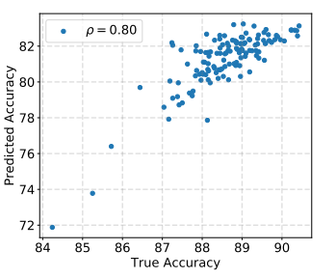
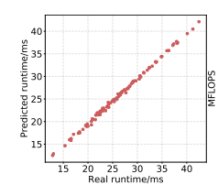
Accuracy estimation: (Francesco)
Done by training a super-net with parameter sharing
Framework only focus is on accuracy rank of a finite number of architectures
The super-net is reconstructed at the beginning of each evolutionary generation, containing only models to be evaluated
Latency Estimation:
Done by using trilinear interpolation
Latency of a model can be represented by the summation of the latency of each layer
Given any input/output channels and weight sparsity, it’s easy to approximate the latency through trilinear interpolation of the 3-D array

Slide 22

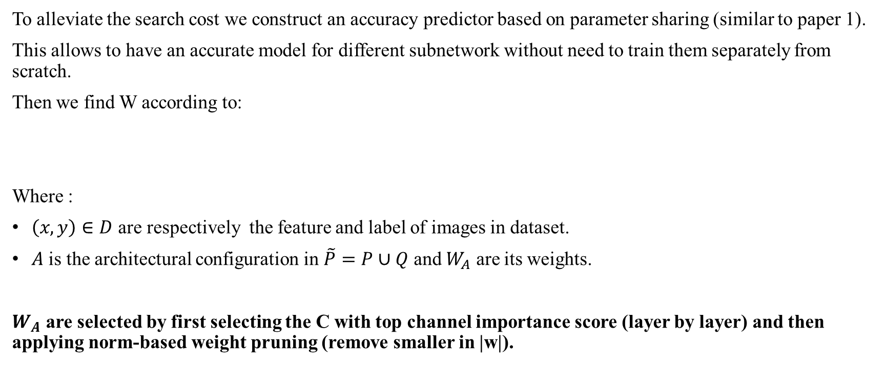
Accuracy estimation (skip)
To alleviate the search cost we construct an accuracy predictor based on parameter sharing (similar to paper 1).
This allows to have an accurate model for different subnetwork without need to train them separately from scratch.
Then we find W according to:
Where :
$\left(x,y\right)∈D$ are respectively the feature and label of images in dataset.
$A$ is the architectural configuration in $\tilde{P}=P∪Q$ and $W_{A}$ are its weights.
$W_{A}$ are selected by first selecting the C with top channel importance score (layer by layer) and then applying norm-based weight pruning (remove smaller in |w|).

Slide 23
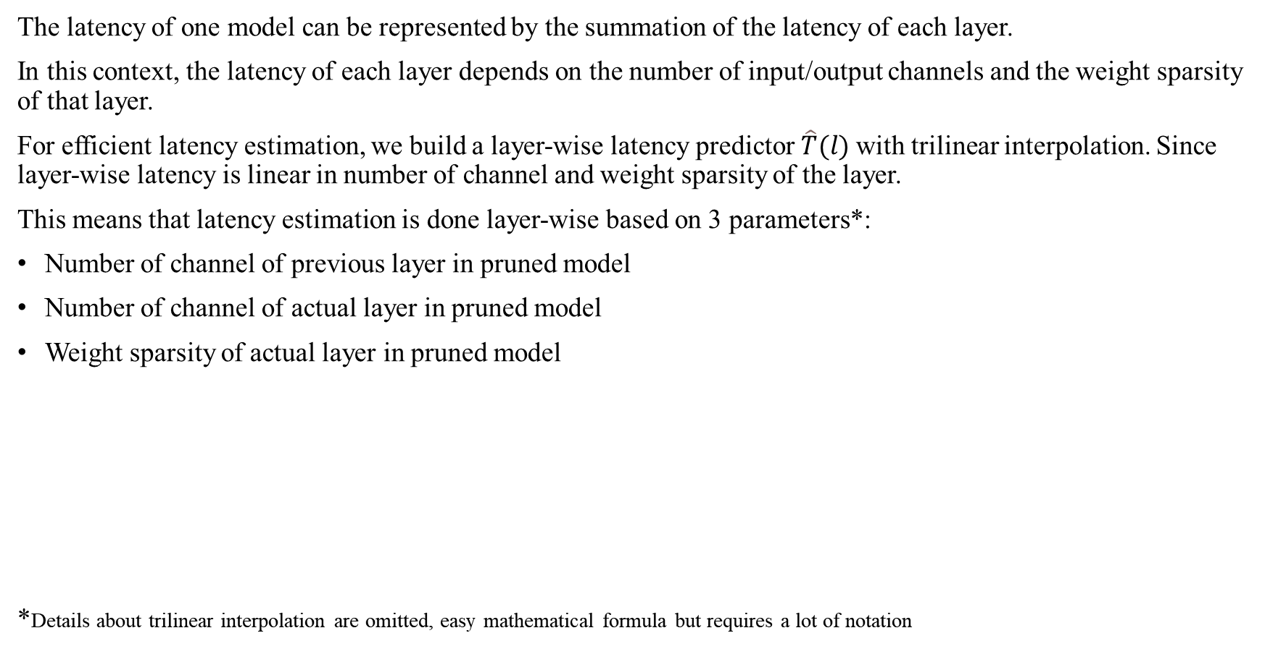
Latency estimation (skip)
The latency of one model can be represented by the summation of the latency of each layer.
In this context, the latency of each layer depends on the number of input/output channels and the weight sparsity of that layer.
For efficient latency estimation, we build a layer-wise latency predictor $\hat{T}(l)$with trilinear interpolation. Since layer-wise latency is linear in number of channel and weight sparsity of the layer.
This means that latency estimation is done layer-wise based on 3 parameters*:
Number of channel of previous layer in pruned model
Number of channel of actual layer in pruned model
Weight sparsity of actual layer in pruned model
*Details about trilinear interpolation are omitted, easy mathematical formula but requires a lot of notation

Slide 24
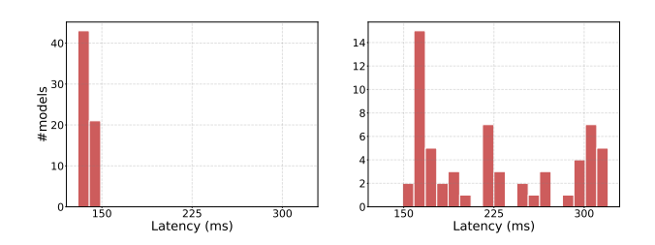
Uniform non-dominated sorting selection: (Francesco)
This selection process generates diverse architectures with various latencies while searching for well-performed models
Selection with non-dominating sorting (left) and without non-dominating sorting (right)

Slide 25

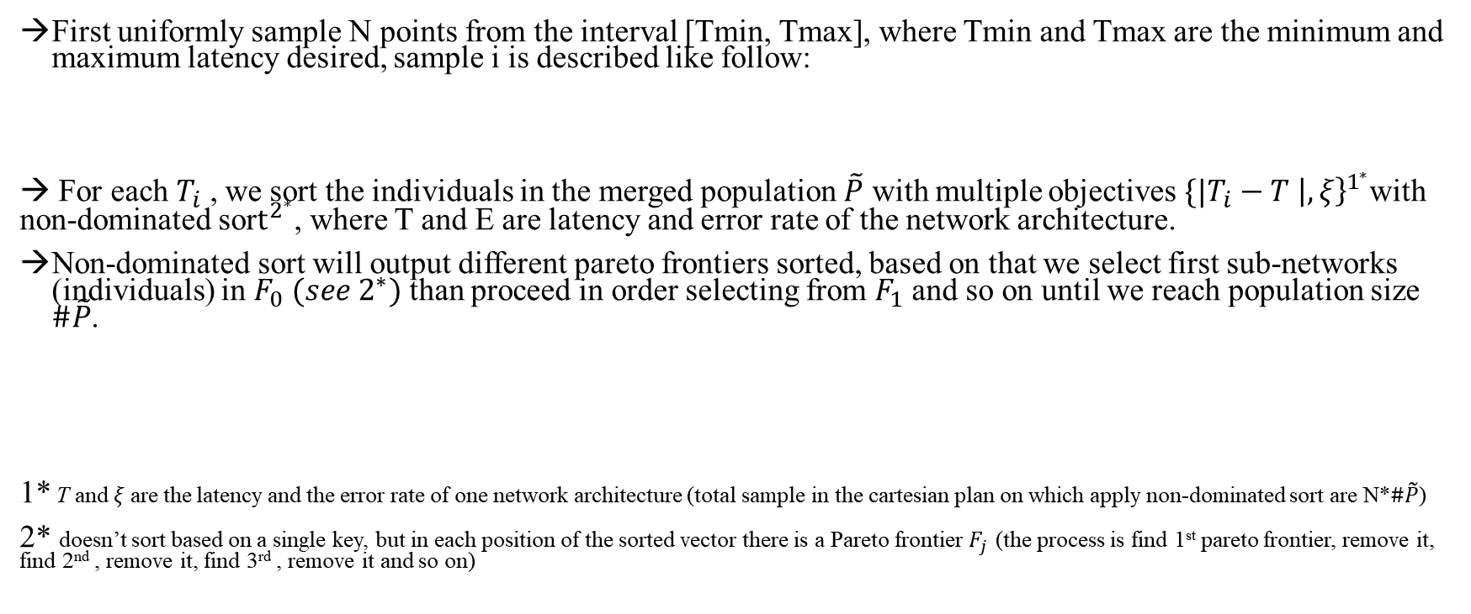
Solution for next generation selection (skip)
First uniformly sample N points from the interval [Tmin, Tmax], where Tmin and Tmax are the minimum and maximum latency desired, sample i is described like follow:
→ For each $T_{i}$ , we sort the individuals in the merged population $\tilde{P}$ with multiple objectives ${\{|T_{i}−T \left|, ξ\right\}}^{1^{∗}}$with non-dominated sor$t^{2^{∗}}$, where T and E are latency and error rate of the network architecture.
Non-dominated sort will output different pareto frontiers sorted, based on that we select first sub-networks (individuals) in $F_{0} (see 2^{∗})$ than proceed in order selecting from $F_{1}$ and so on until we reach population size $\#\tilde{P}$.
1* T and$ξ$are the latency and the error rate of one network architecture (total sample in the cartesian plan on which apply non-dominated sort are N*$\#\tilde{P}$)
2* doesn’t sort based on a single key, but in each position of the sorted vector there is a Pareto frontier $F_{j}$ (the process is find 1st pareto frontier, remove it, find 2nd , remove it, find 3rd , remove it and so on)

Slide 26
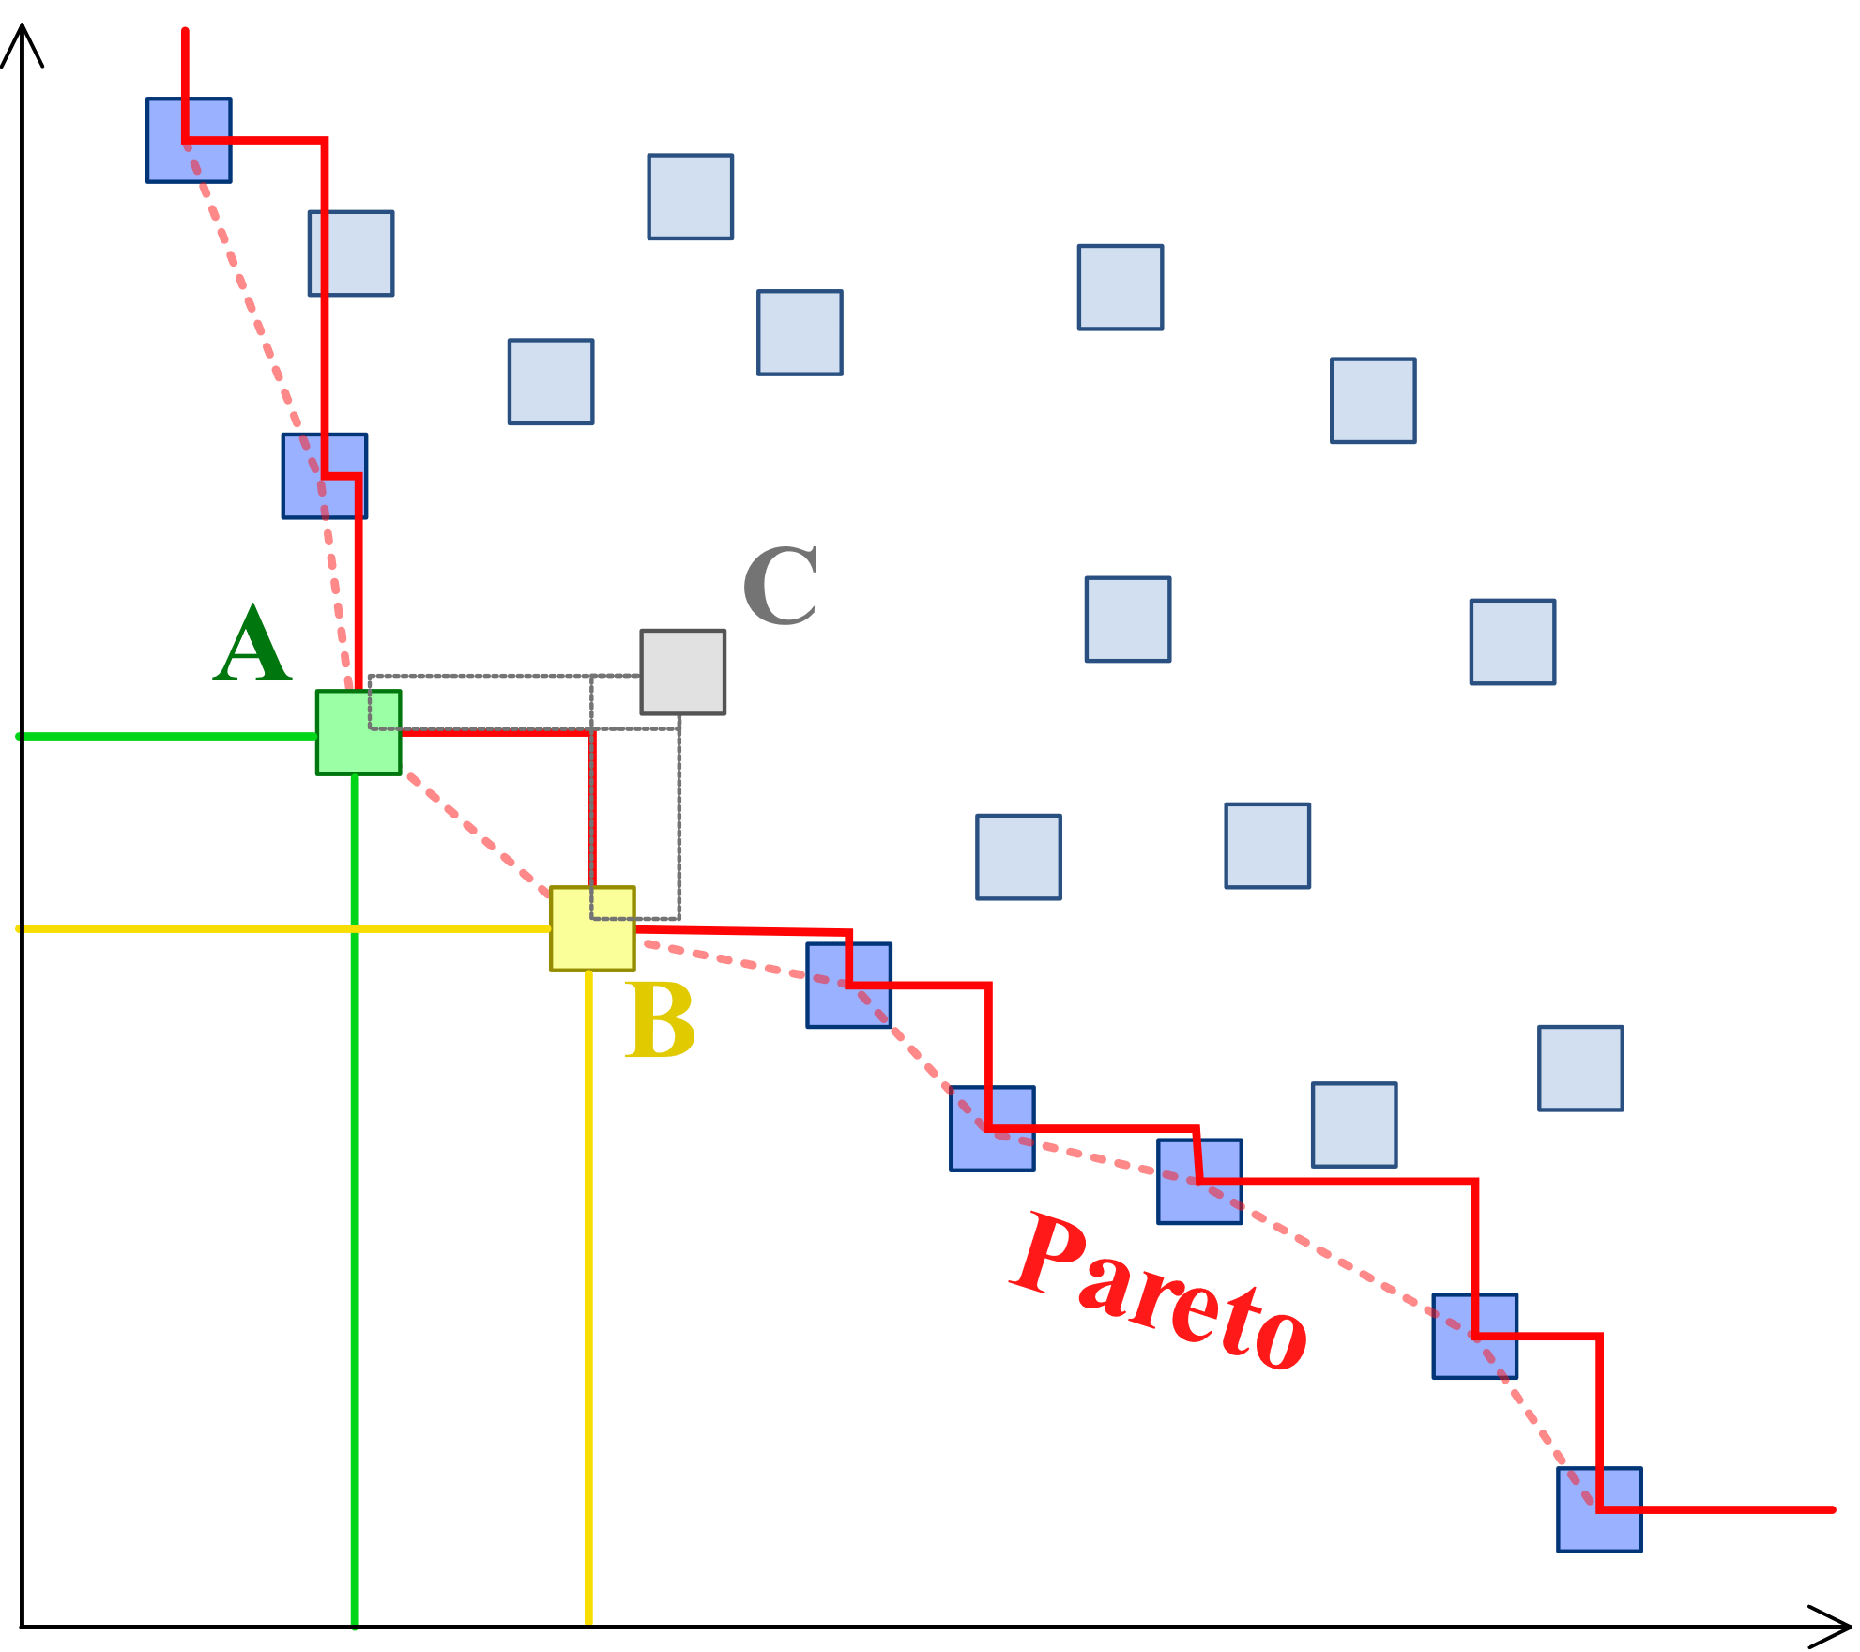
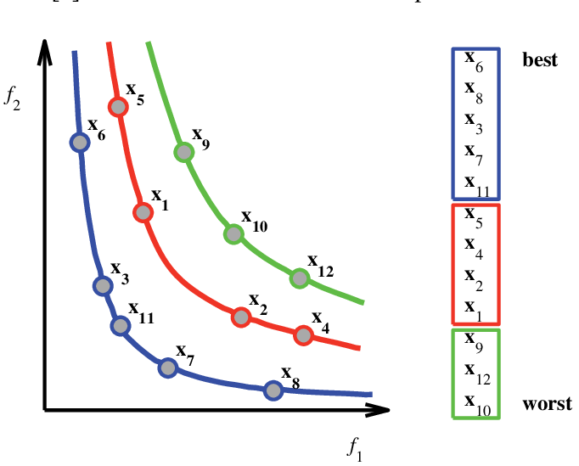
Non-dominated sorting (skip)
f2
bestX=[]
while len(bestX) < desired:
pareto_frontier = []
sort(X, key=f2)
for each x0 in X:
in_frontier = True
for each x1 in X[0,index]: :
if x0.f1<x1.f1:
in_frontier = False
if in_frontier:
pareto_frontier += x0
best_performance_model += pareto_frontier
X -= pareto_frontier
f1
CHECK NO POINTS THERE

Slide 27
Experiments (Federico)
Conducted on ResNet18, MobileNetV1 and MobileNetV2 using the ImageNet dataset
Implemented sparse convolution with improvements for weight pruning, grouping parameters for efficient data reuse.
supernet for 30 epochs with batch size of 256
Evolutionary search with a population size of 64 and 128 search steps.
Supernet training on a subset of ImageNet, followed by re-training on the entire dataset after the search stage
Latency measured on:
ARM Cortex-A72 CPU (1 core)
ARM Cortex-A53 CPU (1 core/4 core)

Slide 28
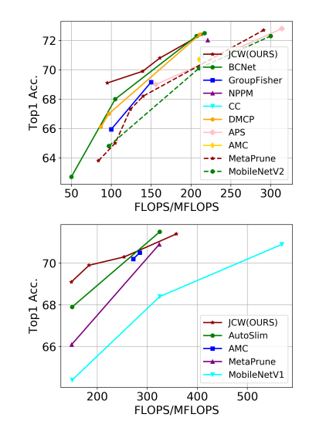
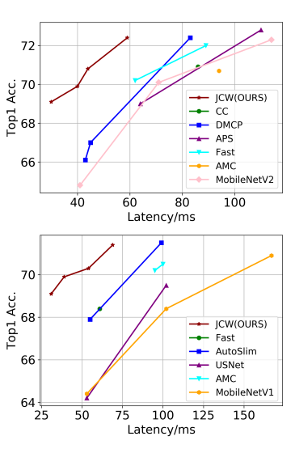
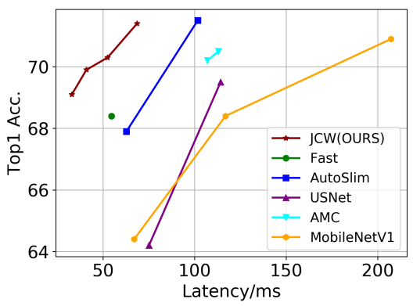
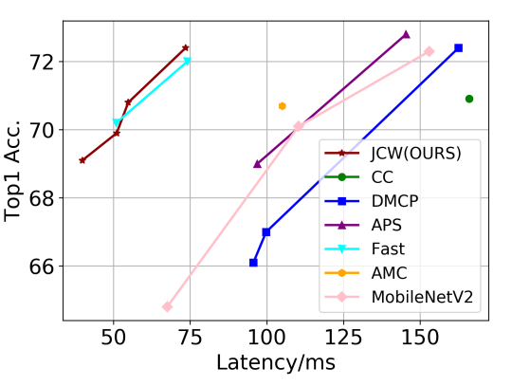
Results (Federico)
FLOPS Real architecture latency (1 CORE) Real architecture latency (4 CORE)
MobileNetV1
MobileNetV2

Slide 29
Conclusions (Federico)
The JCW is the first work investigating the essential part of pruning:
It was demonstrated that this pruning method achieves a better proportion between the channel and weight pruning absorbing both benefits of them.
It was possible to fully optimize the trade-off between latency and accuracy thanks to the multi-objective evolutionary algorithm.

Slide 30
Related works (Federico)
Pareto frontier and MOO in CNN compression:
Dong, J.D., Cheng, A.C., Juan, D.C., Wei, W., Sun, M.: Dpp-net: Device-aware progressive search for pareto-optimal neural architectures. In: Proceedings of the European Conference on Computer Vision (ECCV). pp. 517–531 (2018)
Lu, Z., Whalen, I., Boddeti, V., Dhebar, Y., Deb, K., Goodman, E., Banzhaf, W.: Nsga-net: neural architecture search using multi-objective genetic algorithm. In: Proceedings of the Genetic and Evolutionary Computation Conference. pp. 419– 427 (2019)
Weight pruning:
Han, S., Pool, J., Tran, J., Dally, W.J.: Learning both weights and connections for efficient neural networks. In: Advances in Neural Information Processing Systems
LeCun, Y., Denker, J.S., Solla, S.A.: Optimal brain damage. In: Advances in neural information processing systems. pp. 598–605 (1990)
There are different studies about using EA in network search, one of the earliest:
Deb, K., Pratap, A., Agarwal, S., Meyarivan, T.: A fast and elitist multiobjective genetic algorithm: Nsga-ii. IEEE Transactions on Evolutionary Computation 6(2), 182–197 (2002).

